Slide 1

SSM COET
CHANNEL ROUTING
A SEMINAR
REPORT
PRESENTED
BY
ABDUL BASIT
ENROLL : 5370

Slide 2
CONTENTS
Introduction
Types of Routing
Methods of Routing
Muskingum’s method of Routing
Numericals regarding Muskingum’s method
Conclusion

Slide 3
Introduction
Flood Routing is the technique of determining the flood hydrograph at a section of a river by utilizing the data of flood flow at one or more upstream sections. The hydrologic analysis of problems such as flood forecasting ,flood protection ,reservoir design and spillway design invariably include flood routing.

Slide 4
TYPES OF ROUTING
1.RESERVIOR ROUTING
In reservoir routing the effect of a flood wave entering a reservoir is studied .
2.CHANNEL ROUTING
In channel routing the change in shape of a hydrograph as it travels down a channel is studied.

Slide 5
Methods of routing
1. HYDROLOGIC METHOD
Hydrologic routing methods employ essentially the equation of continuity.
2. HYDRAULIC METHOD
This method of routing employ the continuity equation together with momentum equation .

Slide 6
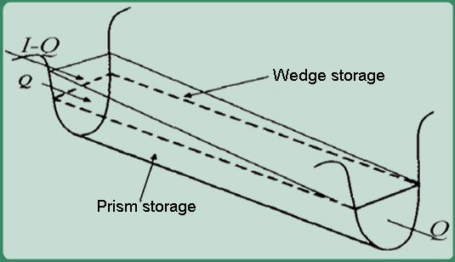
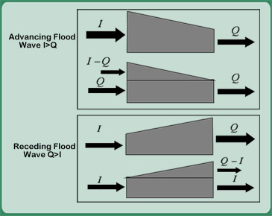
HYDROLOGIC CHANNEL ROUTING
The total volume in storage for a channel reach having a flood wave can be considered as prism storage + wedge storage.

Slide 7
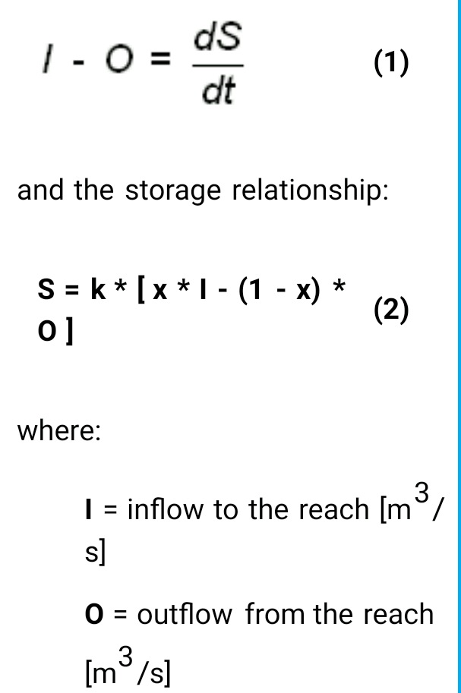
Muskingum’s method
In this method we use equation of continuity and Muskingum’s equation:

Slide 8
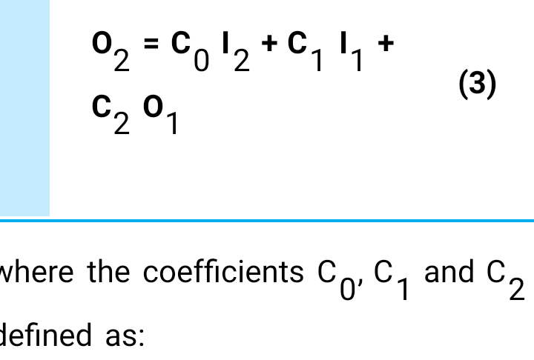
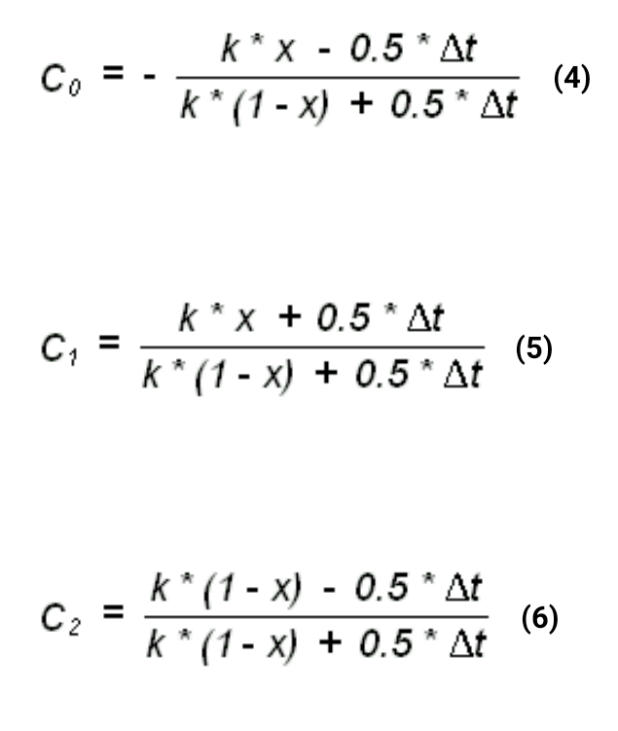

Slide 9
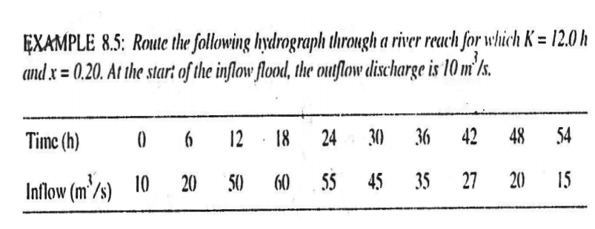
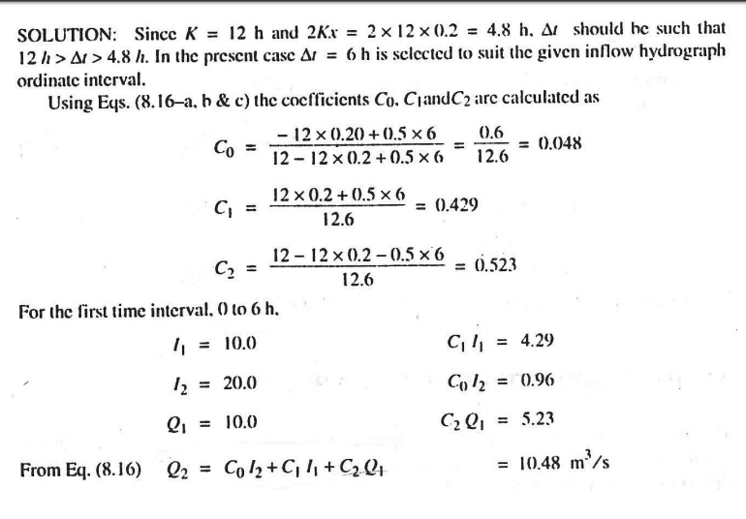
SOME NUMERICALS ON MUSKINGUM’S METHOD

Slide 10
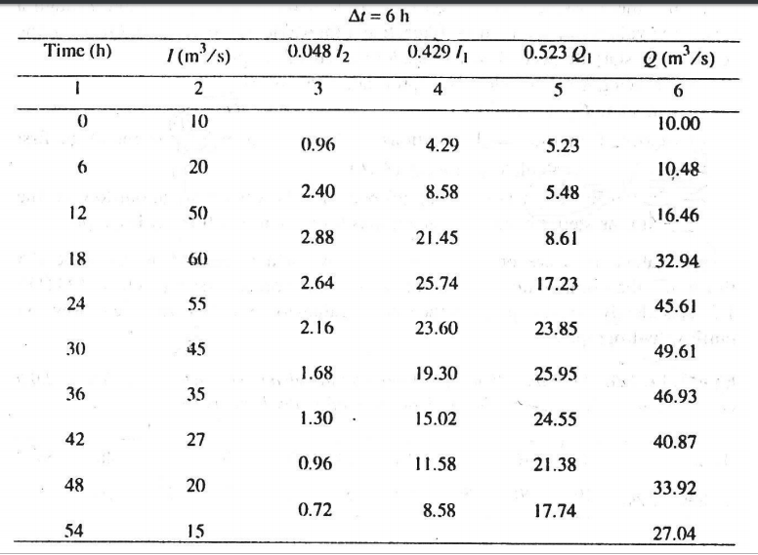

Slide 11
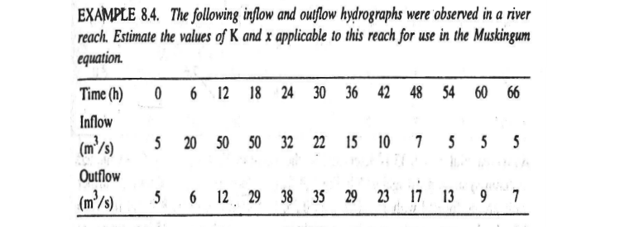
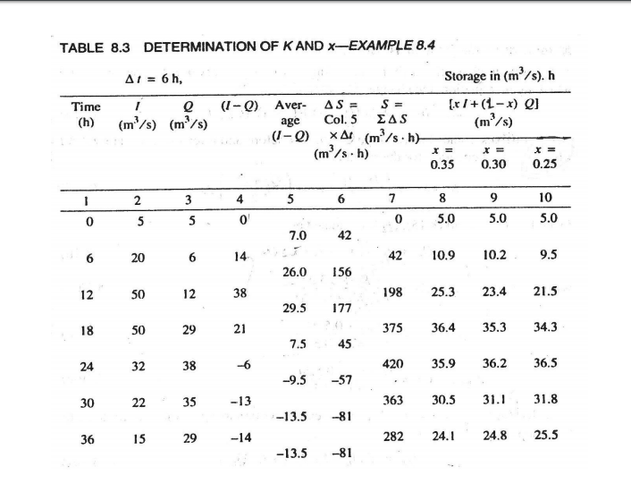

Slide 12
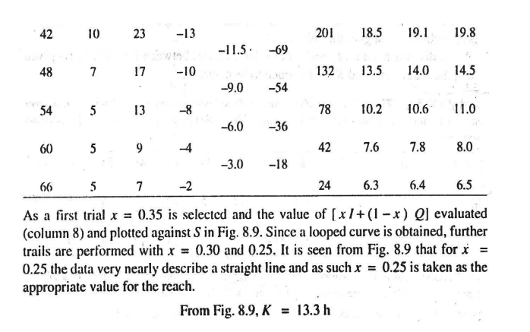
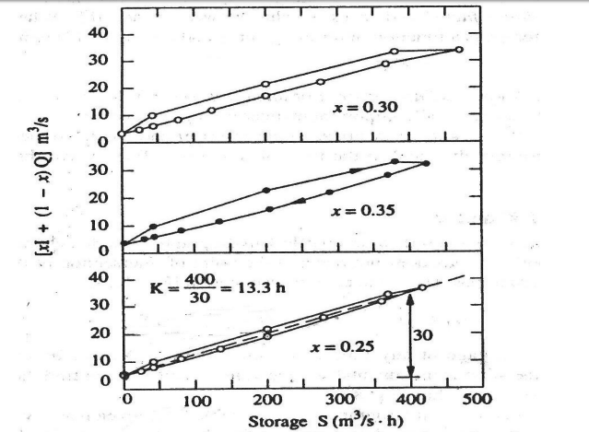

Slide 13
CONCLUSION
By using the known inflow flood parameters at the upstream section of the river section we can determine the outflow parameters at the down stream section

Slide 14
Thank you

